Slide 1
String searching algorithm using BWT and FM index
Milutin Spaić 2019/3058
Genome Informatics

Slide 2
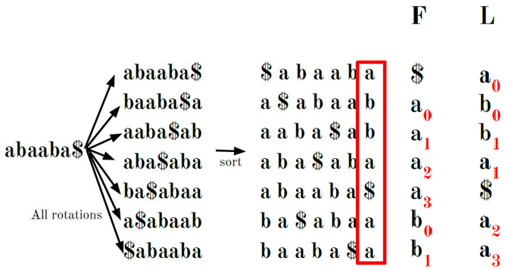
Burrows-Wheeler Transformation
Reversible transformation
Used for data compression
Allows us to quickly search for strings within a string
The B-rank of a character is the number of times that character appears in the string up to where it is located. It is used to find the original string from its BWT

Slide 3
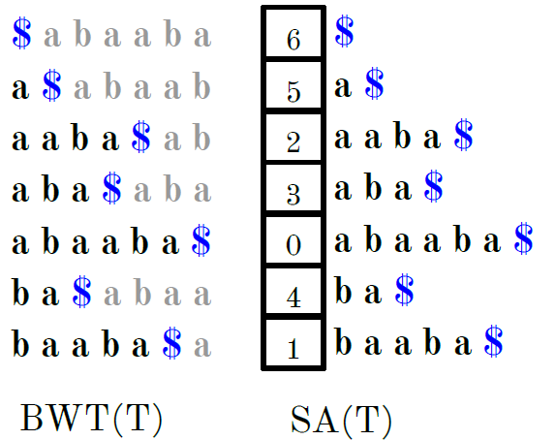
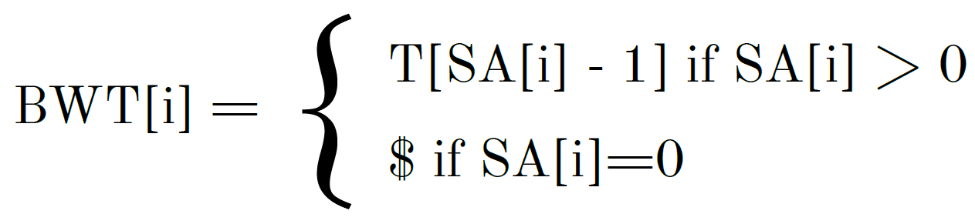
BWt construction
The sorted order is the same regardless of whether the rotations or array suffixes are sorted
The rate of Burrows-Wheeler transformation depends on the rate of formation of the suffix array

Slide 4
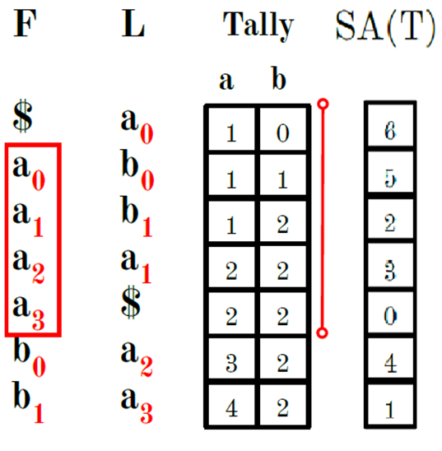
FM-Index
Compressed indexes of substrings of a text based on BWT.
Basic version of the algorithm
The whole suffix array
The whole B-rank array
Optimized version of the algorithm
Thinned suffix array
Thinned tally matrix

Slide 5
coffea arabica
Memory usage in MB for given sequence of the optimized version of the algorithm
Memory usage of the given sequence of the optimized algorithm in relation to the basic algorithm
3929 MB | coffea arabica - ATGCATG[6529] |  |  |  |  | 3929 MB | coffea arabica - ATGCATG[6529]
tally/suffix | 4 | 16 | 64 | 256 |  | tally/suffix | 4 | 16 | 64 | 256
8 | 1374 | 1013 | 920 | 897 |  | 8 | 2.86 | 3.88 | 4.27 | 4.38
32 | 796 | 435 | 342 | 319 |  | 32 | 4.93 | 9.03 | 11.48 | 12.31
128 | 600 | 239 | 146 | 123 |  | 128 | 6.55 | 16.43 | 26.91 | 31.95
512 | 549 | 188 | 95 | 72 |  | 512 | 7.15 | 20.90 | 41.35 | 54.57
3929 MB | coffea arabica - TCTCTCTA[1262] |  |  |  |  | 3929 MB | coffea arabica - TCTCTCTA[1262]
tally/suffix | 4 | 16 | 64 | 256 |  | tally/suffix | 4 | 16 | 64 | 256
8 | 1374 | 1013 | 920 | 897 |  | 8 | 2.86 | 3.88 | 4.27 | 4.38
32 | 796 | 435 | 342 | 319 |  | 32 | 4.93 | 9.03 | 11.48 | 12.31
128 | 600 | 239 | 146 | 123 |  | 128 | 6.55 | 16.43 | 26.91 | 31.95
512 | 549 | 188 | 95 | 72 |  | 512 | 7.15 | 20.90 | 41.35 | 54.57
3929 MB | coffea arabica - TTCACTACTCTCA[0] |  |  |  |  | 3929 MB | coffea arabica - TTCACTACTCTCA[0]
tally/suffix | 4 | 16 | 64 | 256 |  | tally/suffix | 4 | 16 | 64 | 256
8 | 1374 | 1013 | 920 | 897 |  | 8 | 2.86 | 3.88 | 4.27 | 4.38
32 | 796 | 435 | 342 | 319 |  | 32 | 4.93 | 9.03 | 11.48 | 12.31
128 | 600 | 239 | 146 | 123 |  | 128 | 6.55 | 16.43 | 26.91 | 31.95
512 | 549 | 188 | 95 | 72 |  | 512 | 7.15 | 20.90 | 41.35 | 54.57

Slide 6
coffea arabica
Search times of given sequence of the optimized algorithm in relation to the basic algorithm
Search times of given sequence of optimized versions of the algorithm
0.78 sec0 | coffea arabica - ATGCATG[6529] |  |  |  |  | 0.78 sec | coffea arabica - ATGCATG[6529]
tally/suffix | 4 | 16 | 64 | 256 |  | tally/suffix | 4 | 16 | 64 | 256
8 | 0.40 | 0.25 | 0.49 | 1.89 |  | 8 | 0.51 | 0.32 | 0.62 | 2.42
32 | 0.42 | 0.36 | 0.89 | 3.51 |  | 32 | 0.53 | 0.46 | 1.14 | 4.5
128 | 0.50 | 0.73 | 2.49 | 10.02 |  | 128 | 0.64 | 0.93 | 3.19 | 12.84
512 | 0.80 | 2.25 | 8.82 | 35.86 |  | 512 | 1.02 | 2.88 | 11.30 | 46.00
0.78 sec | coffea arabica - TCTCTCTA[1262] |  |  |  |  | 0.78 sec | coffea arabica - TCTCTCTA[1262]
tally/suffix | 4 | 16 | 64 | 256 |  | tally/suffix | 4 | 16 | 64 | 256
8 | 0.38 | 0.16 | 0.13 | 0.41 |  | 8 | 0.48 | 0.20 | 0.16 | 0.52
32 | 0.35 | 0.18 | 0.21 | 0.73 |  | 32 | 0.44 | 0.23 | 0.26 | 0.93
128 | 0.40 | 0.25 | 0.53 | 2.04 |  | 128 | 0.51 | 0.32 | 0.67 | 2.61
512 | 0.46 | 0.55 | 1.80 | 7.27 |  | 512 | 0.58 | 0.70 | 2.30 | 9.32
0.78 sec | coffea arabica - TTCACTACTCTCA[0] |  |  |  |  | 0.78 sec | coffea arabica - TTCACTACTCTCA[0]
tally/suffix | 4 | 16 | 64 | 256 |  | tally/suffix | 4 | 16 | 64 | 256
8 | 0.37 | 0.13 | 0.04 | 0.01 |  | 8 | 0.47 | 0.16 | 0.05 | 0.01
32 | 0.37 | 0.13 | 0.04 | 0.01 |  | 32 | 0.47 | 0.16 | 0.05 | 0.01
128 | 0.37 | 0.13 | 0.04 | 0.01 |  | 128 | 0.47 | 0.16 | 0.05 | 0.01
512 | 0.37 | 0.13 | 0.04 | 0.01 |  | 512 | 0.47 | 0.16 | 0.05 | 0.01
0.47

Slide 7
questions?
Source code: https://github.com/mspaic96/GenomeInformatics
E-Mail:milutin.spaic@yahoo.com

